Slide 1

Natural Language Processing DLO 8012
Subject In-charge
Ms Vincy Joseph
Assistant Professor
email: vincyjoseph@sfit.ac.in

Slide 2
Module V
Lecture 26 Discourse Integration

Slide 3
Example
Gracie: Oh yeah. . . and then Mr. and Mrs. Jones were having matrimonial trouble, and my brother was hired to watch Mrs. Jones.
George: Well, I imagine she was a very attractive woman.
Gracie: She was, and my brother watched her day and night for six months.
George: Well, what happened?
Gracie: She ﬁnally got a divorce.
George: Mrs. Jones?
Gracie: No, my brother’s wife.

Slide 4
Example
This is a dialogue part of a movie.
Language consist of collocated, structured, coherent groups of sentences.
Such a coherent structured group of sentences is called a discourse.

Slide 5
Dialogue
The dialogue discourse consist of different types of communicative acts as:
asking questions
giving answers
making corrections, and so forth.

Slide 6
Example
Consider the discourse below:
The Tin Woodman went to the Emerald City to see the Wizard of Oz and ask for a heart. After he asked for it, the Woodman waited for the Wizard’s response.
What do pronouns such as he and it denote?
But doing this disambiguation automatically is a difﬁcult task.

Slide 7
Coreference Resolution
The goal of deciding what pronouns and other noun phrases refer to is called coreference resolution.
Coreference resolution is important for
Information Extraction
Summarization
Conversational Agents
There are other important discourse structures beside coreference resolution.

Slide 8
Coherence Relations
Consider the task of summarization below:
Text:
First Union Corp is continuing to wrestle with severe problems. According to industry insiders at Paine Webber, their president, John R. Georgius, is planning to announce his retirement tomorrow.
Summary:
First Union President John R. Georgius is planning to announce his retirement tomorrow.

Slide 9
Coherence Relations
To build such a summary, we need to know that the second sentence is the more important of the two, and that the ﬁrst sentence is just giving background information.
Relationships of this sort between sentences in a discourse are called coherence relations
Determining the coherence structures between discourse sentences is an important discourse task

Slide 10
Coherence Relations
In automatic essay grading, short student essays are assigned a grade by measuring the internal coherence of the essay as well as comparing its content to source material which is a high-quality essay.
It is also used to evaluate the output quality of natural language generation systems.

Slide 11
Reference Resolution
Consider the following example:
John went to Bill’s car dealership to check out an Acura Integra. He looked at it for about an hour.
A natural language expression used to perform reference is called a referring expression (He,it) and the entity that is referred to is called the referent.(John,Car)

Slide 12
Reference Resolution
In the example,
Referring expression: He , it
Referent : John,Acura Integra
Co-referring Expression : Two referring expressions that are used to refer to the same entity. (Not in this example)
Antecedent : John is the antecedent of he.
Anaphora : Reference of an entity that has been previously introduced into the discourse.(here: he)

Slide 13
Exercise
Sam left Peter to be mayor of a city with a big budget problem. It is unclear how he will be able to handle it during his term.
Referring expressions: ?
Referents: ?
Co-referring expressions: ?
Antecedent: ?
Anaphora: ?

Slide 14
Exercise
Referring expressions: he, it, his.
Referents: Peter, big budget problem
Co-referring expressions: he, his (Both referring to Peter)
Antecedent: Peter, Big budget problem
Anaphora: he, his , it

Slide 15
Discourse Model
The discourse model contains representations of the entities that have been referred to in the discourse and the relationships in which they participate.
There are 2 fundamental operations to discourse model.
When a referent is first mentioned in a discourse, we say that a representation for it is evoked into the model.
Upon subsequent mention, this representation is accessed from the model.

Slide 16
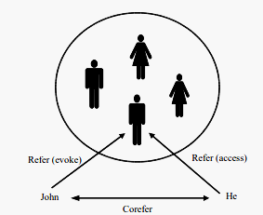
Discourse Model
Example:
John went to Bill’s car dealership to check out an Acura Integra. He looked at it for about an hour.

Slide 17
Consider the example given below:
“According to John, Bob bought Sam an Integra, and Sam bought Fred a Legend.”
But that turned out to be a lie.
But that was false.
That struck me as a funny way to describe the situation.
That caused Sam to become rather poor.
That caused them both to become rather poor.

Slide 18
Example
But that turned out to be a lie: a speech act
But that was false: a proposition
That struck me as a funny way to describe the situation: a manner of description
That caused Sam to become rather poor : an event
That caused them both to become rather poor : a combination of several events.
Thus the field awaits the development of robust methods for interpreting these types of reference.

Slide 19
Chatbot with Discourse Integration

Slide 20
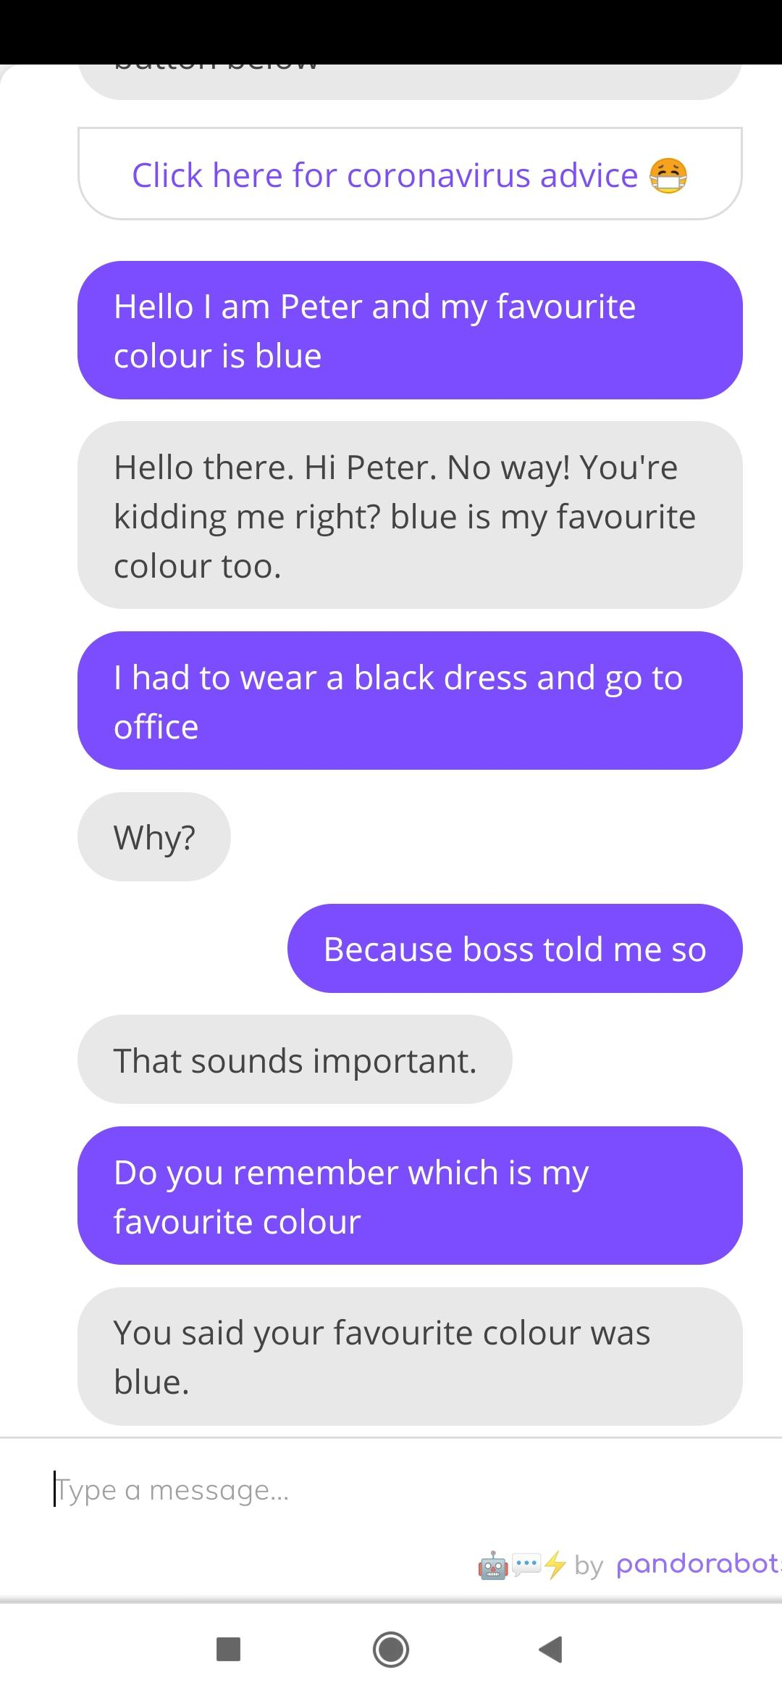

Slide 21
Chatbot without Discourse Integration

Slide 22
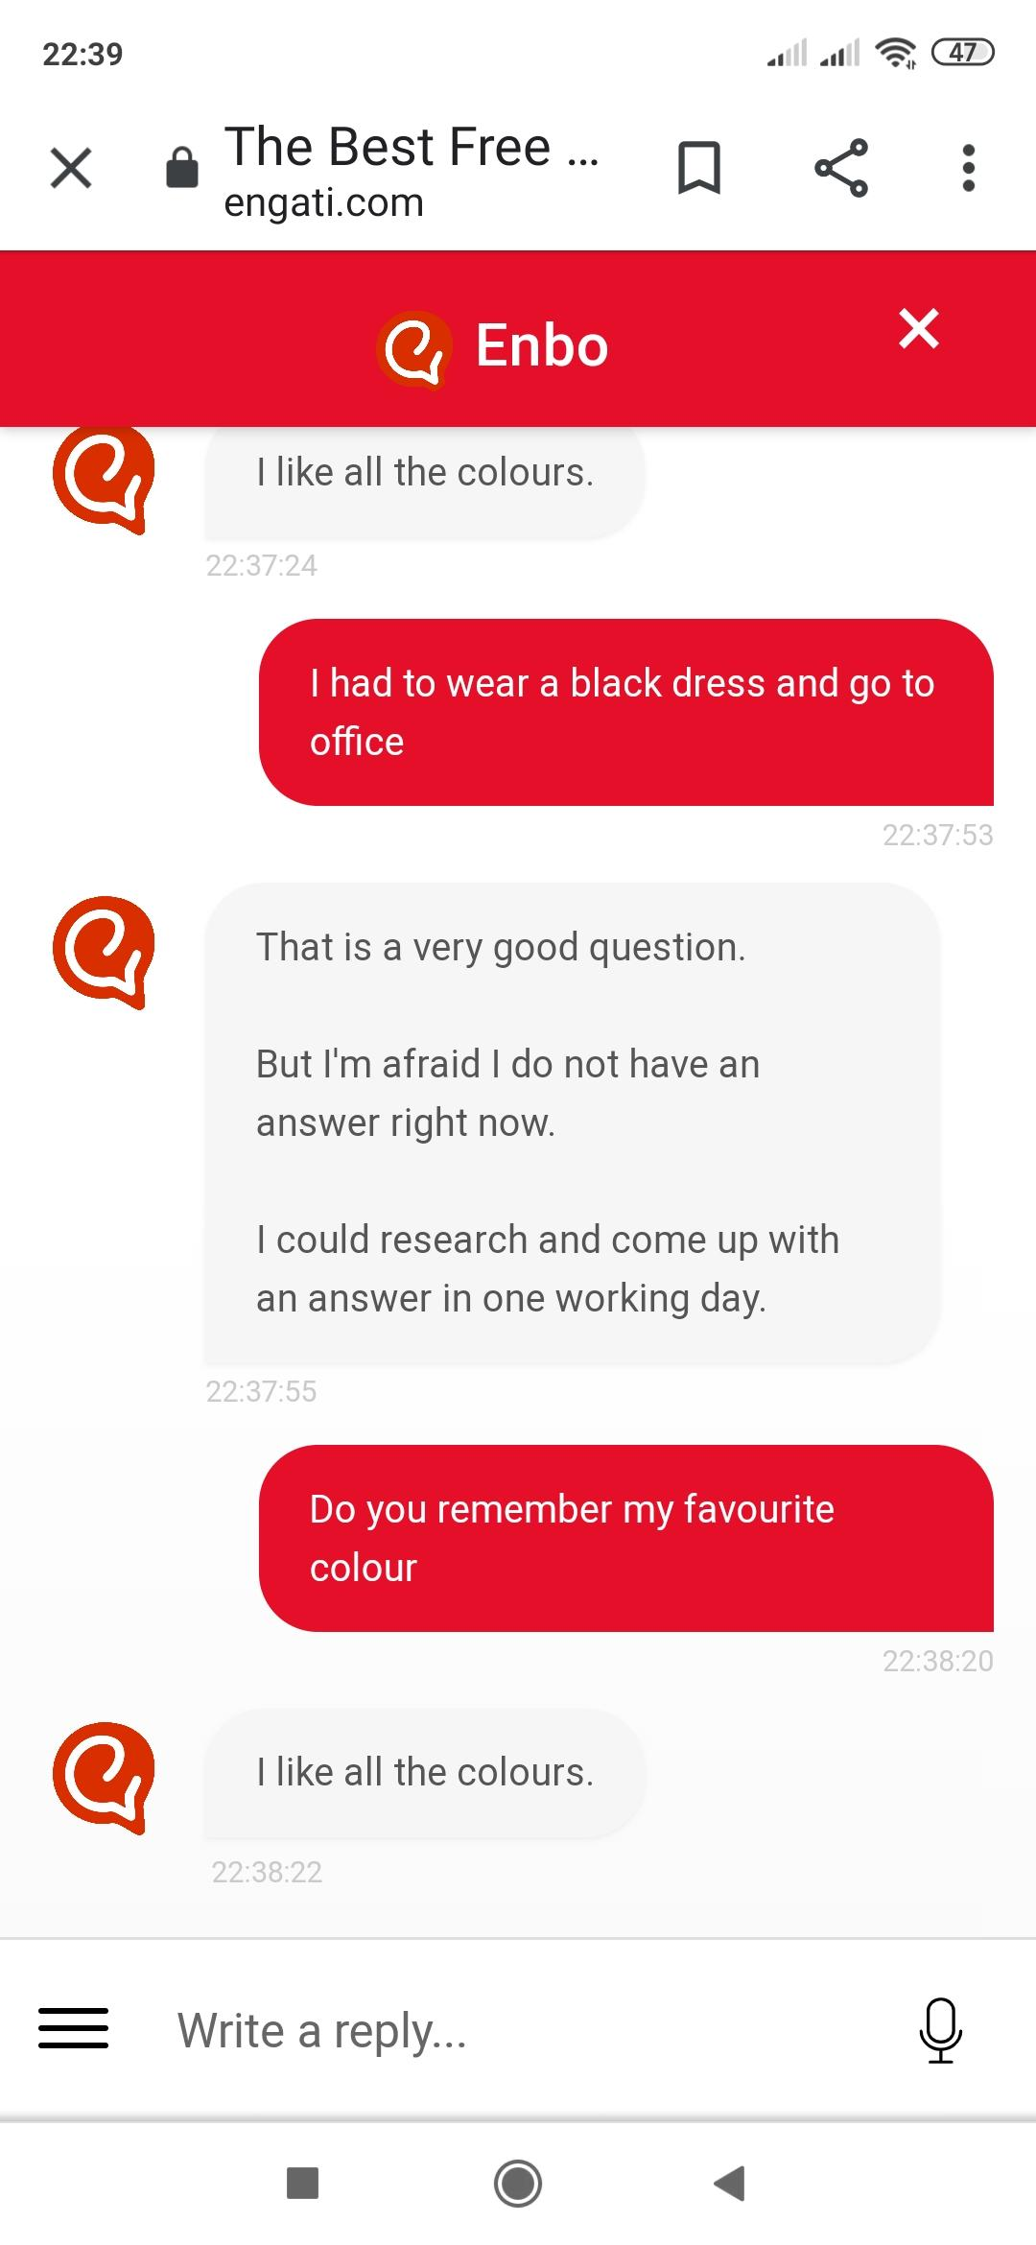

Slide 23
Reference Phenomena
There are several referential phenomena in natural languages.
Five among them explored here are:
Indefinite noun phrases, definite noun phrases, pronouns, demonstratives and one-anaphora.
Three types of referents complicate the reference resolution problem:
Inferrables, discontinuous sets, and generics.

Slide 24
Indefinite Noun Phrases
Indefinite reference introduces entities that are new to the hearer into the discourse context.
Common form of indefinite reference is marked with the determiner a (or an),by a quantifier (some) or even determiner this.
I saw a Mercedes Benz today.
Some Mercedes Benz were being unloaded at the local dealership today.
I saw this awesome Mercedes Benz today.

Slide 25
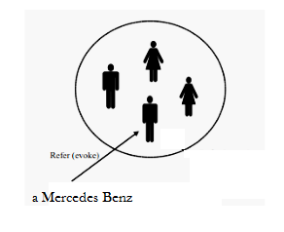
Indefinite Noun Phrases
Such noun phrases evoke a representation for a new entity.

Slide 26
Definite Noun Phrases
Deﬁnite reference is used to refer to an entity that is
identiﬁable to the hearer
it is contained in the hearer’s set of beliefs about the world
the uniqueness of the object is implied by the description itself.
E.g.
I saw an Acura Integra today. The Integra was white and needed to be washed.
The Indianapolis 500 is the most popular one in US.
The fastest car in the Indianapolis 500 was an Integra.

Slide 27
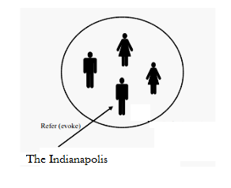
Definite Noun Phrases
A Definite Noun Phrase also evokes a representation of the referent into the discourse model.

Slide 28
End

